Slide 1
CRYPTO SWAP
A mobile application

Slide 2
TABLE OF CONTENT
Abstract
Introduction
Literature Survey
Design
Software Requirements
01

Slide 3
Abstract
Cryptoswap is a groundbreaking project aimed at introducing a decentralized exchange platform that empowers users to securely and efficiently swap cryptocurrencies.This innovative platform leverages blockchain technology and smart contracts to provide a transparent trading experience. The frontend of this mobile application is built using flutter. Blockchain is a transformative technology that has revolutionized various industries by providing a decentralized, secure, and transparent means of recording and verifying transactions. At its core, blockchain is a distributed digital ledger that stores data across a network of computers, ensuring immutability and trust without the need for intermediaries. Flutter is a versatile open-source framework developed by Google for building natively compiled applications across various platforms from a single codebase.
02

Slide 4
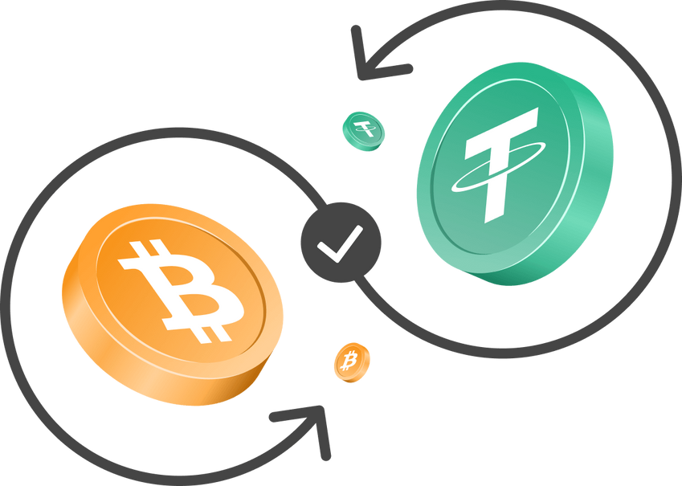
Introduction
Our application provides a revolutionary platform that leverages Metamask wallet accounts to facilitate secure and seamless cryptocurrency swapping, while also providing real-time price data for Bitcoin and Ethereum cryptocurrencies. Blockchain and Flutter form the respective backend and the frontend for the application. Crypto Swap is a gateway to the future of decentralized finance, simplifying cryptocurrency trading ever-evolving digital asset market.
03

Slide 5
Literature Survey
Smart Contracts and Ethereum (2015): The introduction of Ethereum in 2015 revolutionized the cryptocurrency space by allowing for the creation of smart contracts. Ethereum was co-founded by Vitalik Buterin and has since sparked significant research and development in the field of decentralized applications (dApps) and smart contract platforms.
04

Slide 6
Zero-Knowledge Proofs (e.g., ZK-SNARKs, ZK-STARKs, 2012 and onwards): Cryptographers have contributed to the development of zero-knowledge proofs, which are used to enhance privacy in blockchain transactions. These cryptographic techniques have found applications in various blockchain projects.
Cross-Chain Atomic Swaps (2017 and onwards): Scientists and blockchain developers have explored and implemented atomic swaps, a technology that allows users to directly exchange different cryptocurrencies across different blockchains without the need for intermediaries.
05

Slide 7
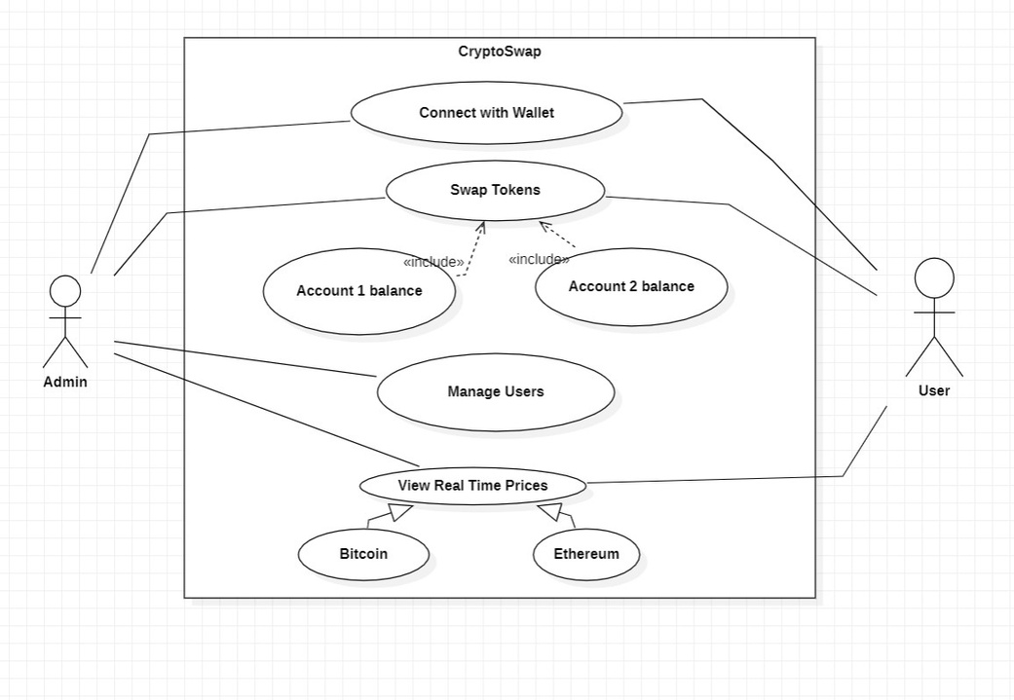
Design
Use Case Diagram :
06

Slide 8
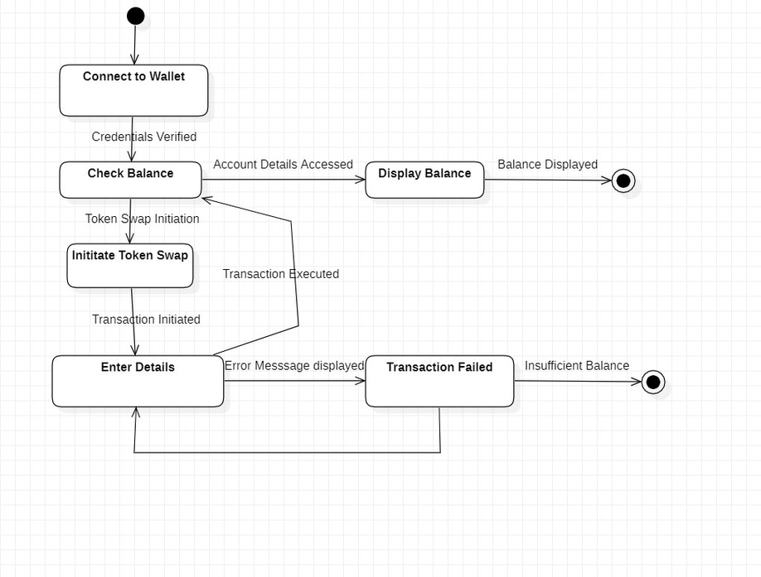
State Chart Diagram :
07

Slide 9
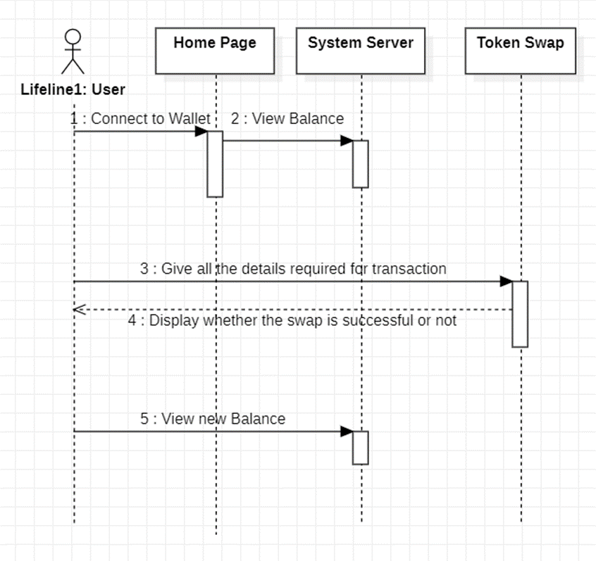
Sequence Diagram :
08

Slide 10
Software Requirements
Frontend :
Flutter
Metamask mobile application
Backend :
Solidity ( Smart contracts )
Blockchain
09

Slide 11


Thank You
11109

